Slide 1

DIGITAL PORTFOLIO
STUDENT NAME : TAMILARASI.R
REGISTER NO AND NMID: 24H239,asunm3, 1A063B7423E55BC9540425B53DE028BE
DEPARTMENT : BCA
COLLEGE : AM JAIN COLLEGE

Slide 2

DIGITAL PORTFOLIO

Slide 3




AGENDA
1.Problem statement
2.Project Overview
3.End Users
4.Tools and Technologices
5.Portfolio design and Layout
6.Features and Functionality
7.Results and Screenshots
8.Conclusion
9.Github link

Slide 4

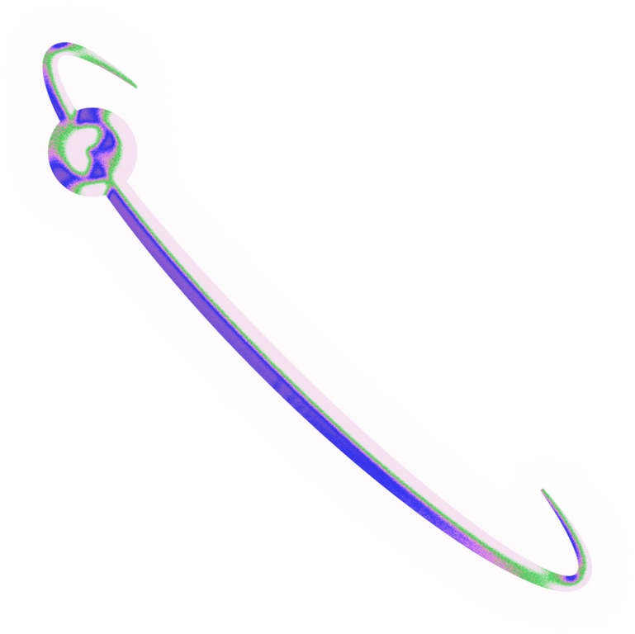
PROBLEM STATEMENT
Many digital professionals struggle to showcase their skills , projects, and expertise in a visually engaging and interactive manner.A well - designed portfolio is essential to highlight achievements and attract opportunities.

Slide 5
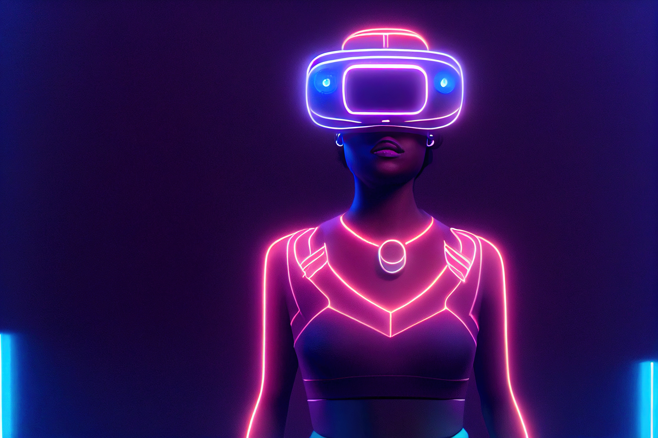
PROJECT OVERVIEW
This Project is a personal digital portfolio Website by Tamilarasi.R,a frontend developer and UI/UX designer. It presents professional details, skills, projects,and contact information in a modern,responsive layout.The portfolio combines design and interactivity to create an engaging user experience.

Slide 6

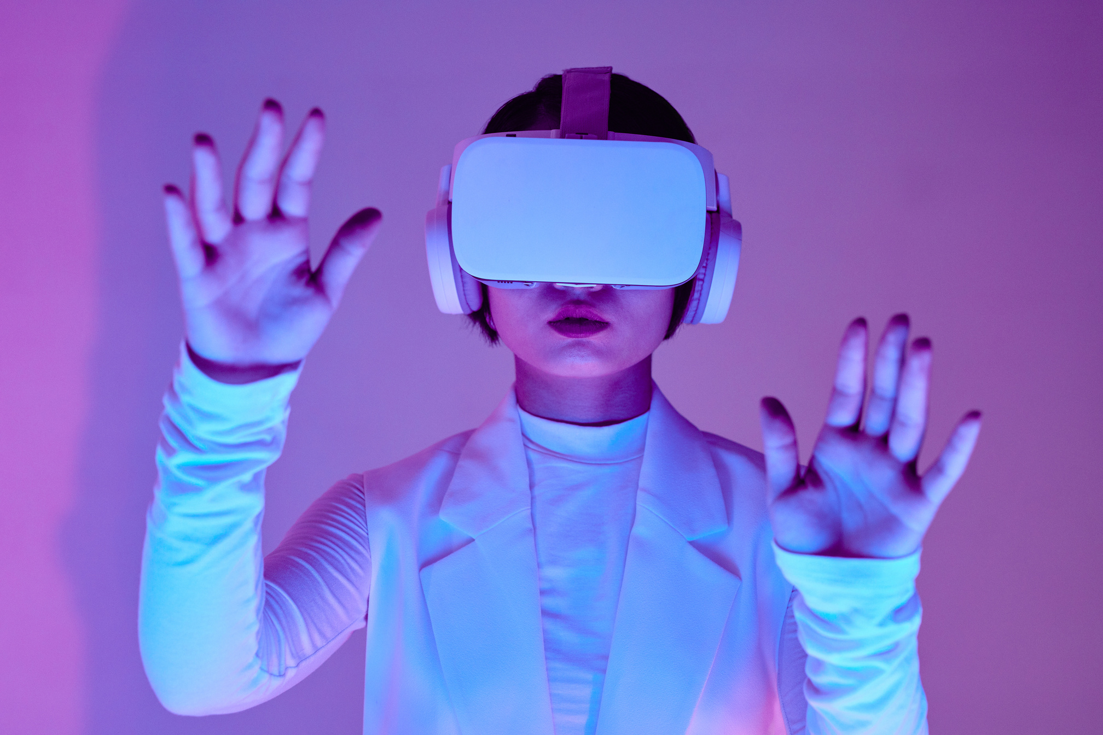
WHO ARE THE END USERS?
Recruiters and hiring managers
Clients looking for freelance
developers/designers
peers and collaborators in the
tech/design field...

Slide 7

TOOLS AND TECHNIQUES
HTML5 FOR STRUCTURE CSS3 FOR STYLING AND RESPONSIVE DESIGN JAVASCRIPT FOR INTERACTIVITY (NAVIGATION, ANIMATION, SPARKLE EFFECT) FONT AWESOME FOR ICONS
EXTERNAL ASSETS:UNSPLASH IMAGES FOR
VISUALS

Slide 8

Fixed header with logo, navigation,and hamburger menu for mobile view
Hero section introducing the name, role, and tagline with call -to-action button
About section with profile image, biography, and animated skill bars
projects section displaying work in responsive grid cards with tags and hover effects
Contact section including location, email, phone,and a functional contact form Footer with social media links and copyright....
PORTFOLIO DESIGN AND LAYOUT

Slide 9
Smoothscrolland animated navigation menu sparkle effect on buttons for
interactive engagement
Responsive skill bar animations using
intersection observer
Dyanamic hamburger menu for mobile devices
Contact form for easy communication
project cards with hover scaling and
interactive tags....
FEATURES AND FUNCTIONALITY

Slide 10
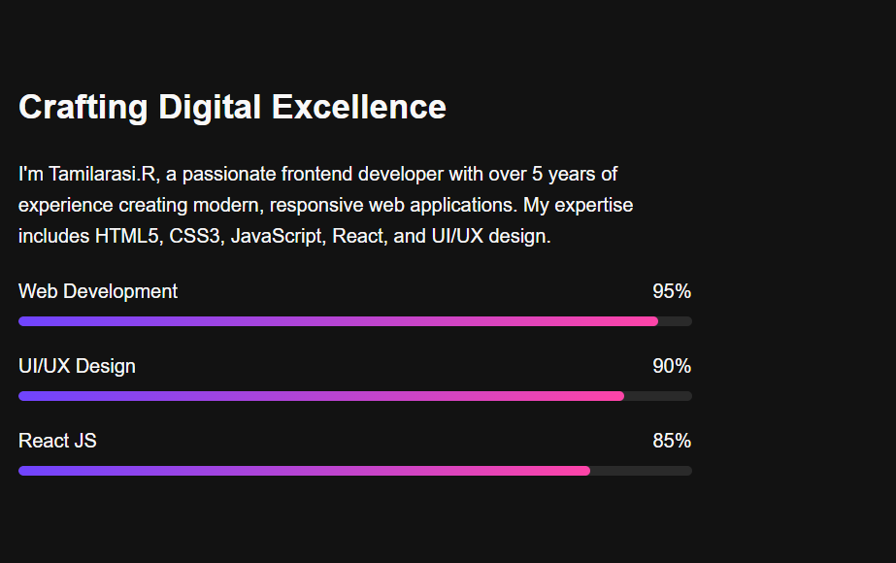
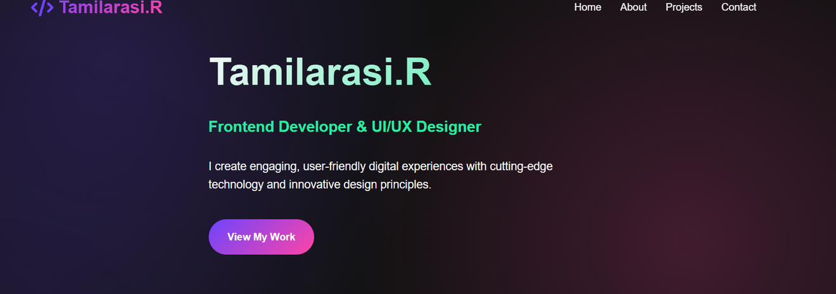
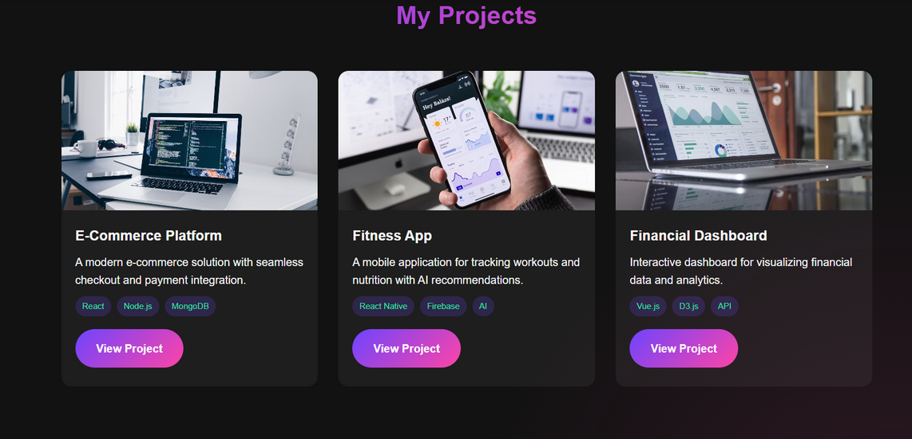
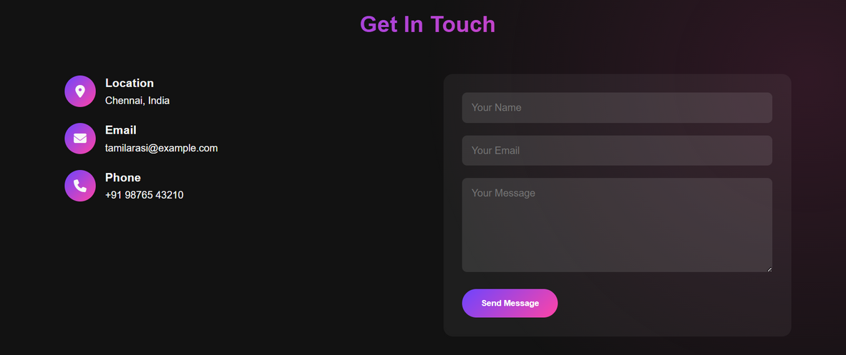
RESULTS AND SCREENSHOTS

Slide 11


CONCLUSION
The project successfully demonstrates modern frontend development and design practices .It serves as a professional showcase for skills, projects, and contact details, helping Tamilarasi.R connect with opportunities in the digital space...
THANK YOU !!!!

